Slide 1
SAFETY
SHOWDOWN
Subject Category 1
Subject Category 2
Subject Category 3

Slide 2
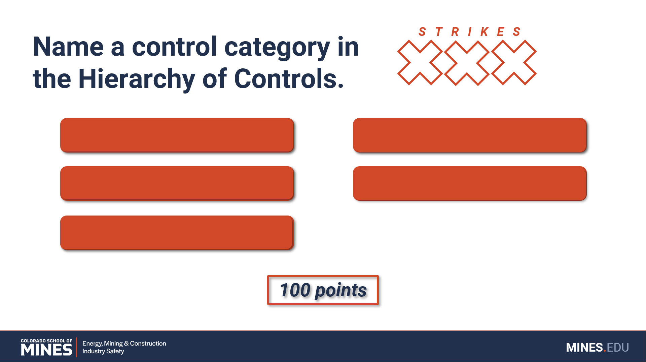
How to play SAFETY SHOWDOWN
Safety Showdown is based on the game show Family Feud.
Two teams.
Each round consists of answering one question that has multiple answers. Each answer to the question is ranked, worth a different amount of points that add up to equal the total number of points possible to earn in the round.

Slide 3
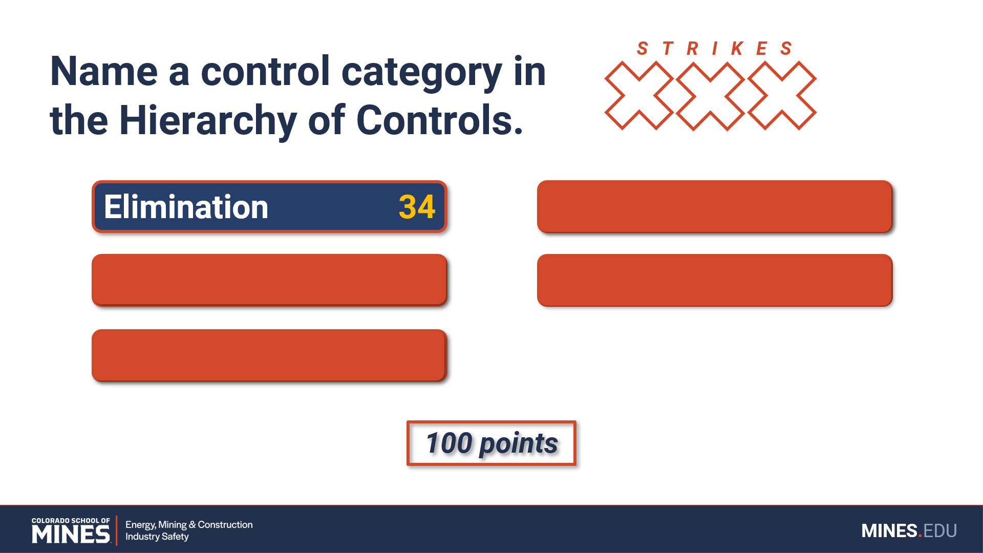
How to play SAFETY SHOWDOWN
Teams take turns beginning each round. Once the host has read the question, the team with control gets 10 seconds to confer and guess an answer. If their answer is not the highest-ranked answer, the other team is given ten seconds to answer. For whichever answer is the highest-ranked, that team can choose to play the round or pass to the other team.

Slide 4
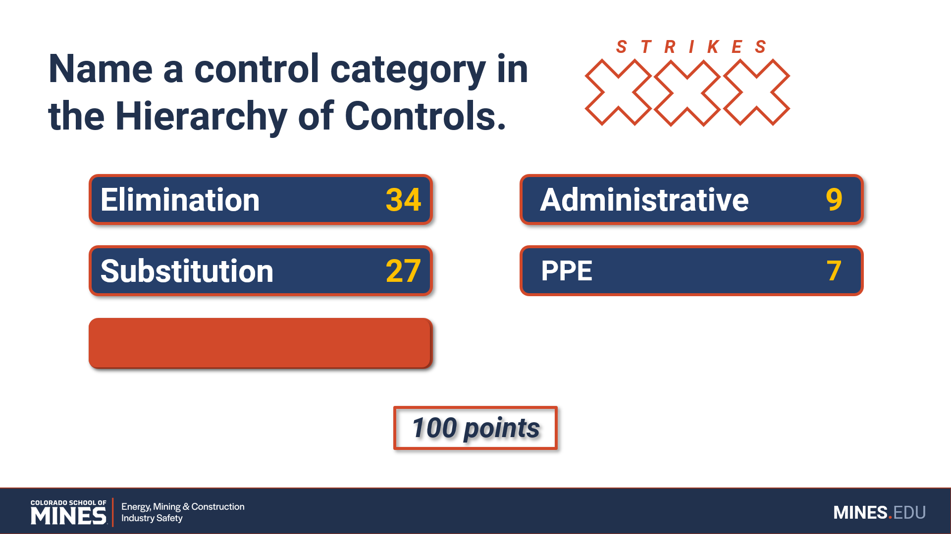
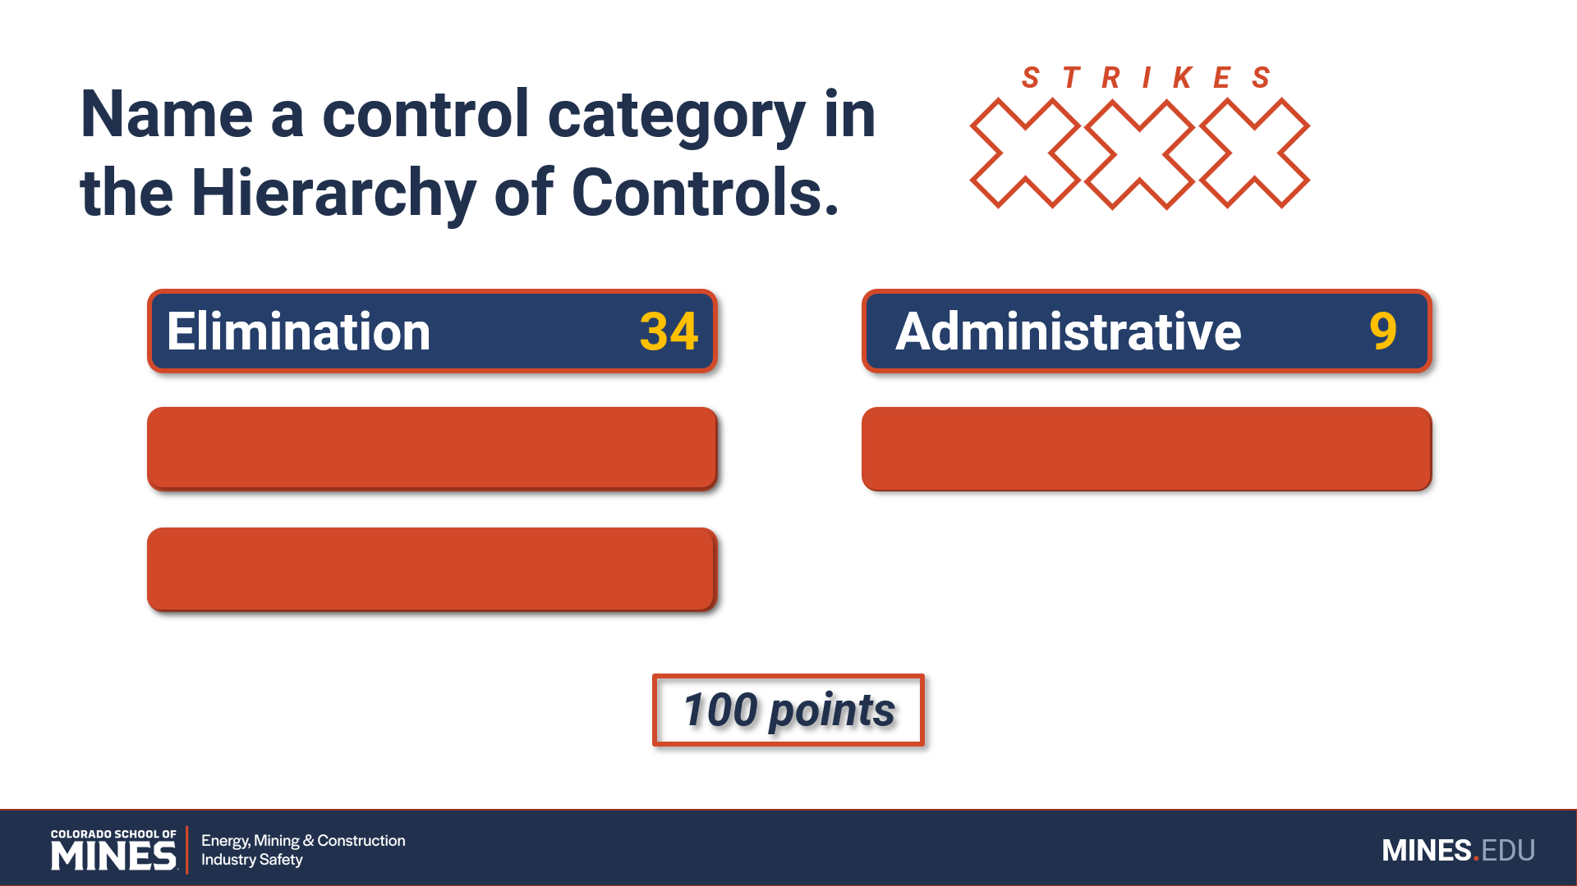
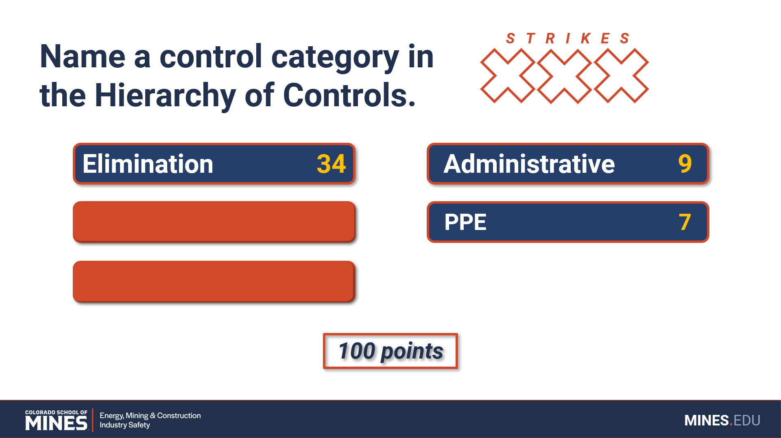
How to play SAFETY SHOWDOWN
The active team then continues to guess answers on the board. For each correct answer, the team may continue to guess until all the answers on the board are revealed, winning the round, and earning the team full points for the round.

Slide 5
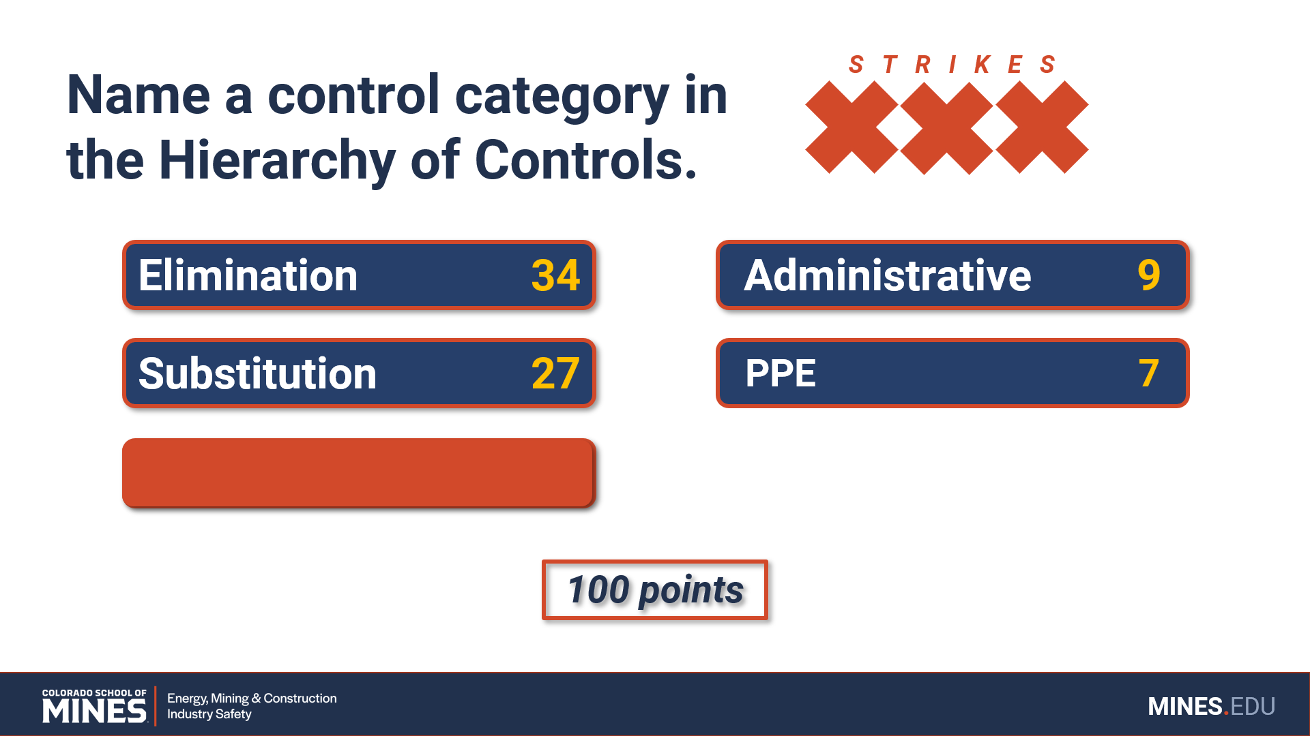
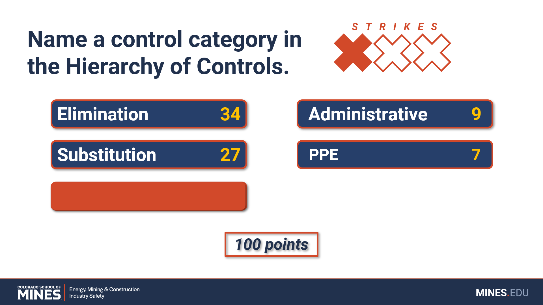
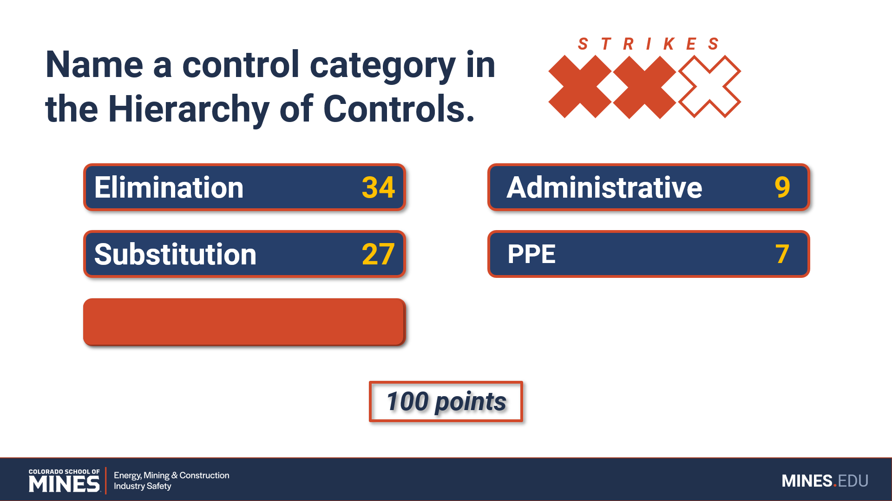
How to play SAFETY SHOWDOWN
For each incorrect answer, the team is given a strike. At three strikes, control of the round is given to the opposing team. That team may then make one guess to reveal one of the remaining answers. With a correct guess, the team steals the win and earns the team full points for the round. With an incorrect guess, the other team wins the round and keeps only the points they earned for their correct answers.

Slide 6
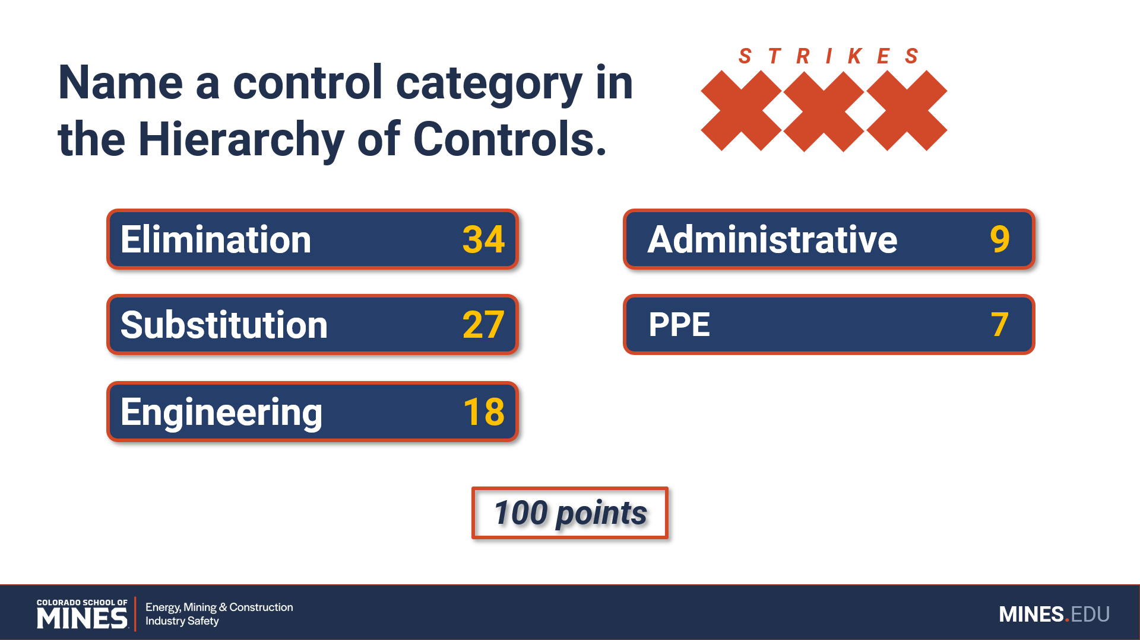
How to play SAFETY SHOWDOWN
Many question rounds have bonus answers: If a player gives a correct answer that is not in the list, the team is awarded the given amount of bonus points.
A bonus point answer cannot be used to steal the round, but the bonus points will still be awarded.

Slide 7
How to play SAFETY SHOWDOWN
For any given question, teams have ten seconds to answer. Not answering within ten seconds is considered incorrect and a strike.
The team with the most points at the end of the allotted time wins the AWESOME PRIZE™.

Slide 8

Subject Category
21 POINTS

Slide 9
Question text
S T R I K E S
Answer 1 6
Answer 4 3
Answer 2 5
Answer 5 2
Answer 3 4
Answer 6 1
BONUS ANSWER: 2 POINTS
21 points

Slide 10
Question text
Answer 1 6
Answer 4 3
Answer 2 5
Answer 5 2
Answer 3 4
Answer 6 1
BONUS ANSWER: 2 POINTS
21 points

Slide 11
Subject Category
28 POINTS

Slide 12
Question text
S T R I K E S
Answer 1 7
Answer 5 3
Answer 2 6
Answer 6 2
Answer 3 5
Answer 7 1
Answer 4 4
28 points

Slide 13
Question text
Answer 1 7
Answer 5 3
Answer 2 6
Answer 6 2
Answer 3 5
Answer 7 1
Answer 4 4
28 points

